Slide 1
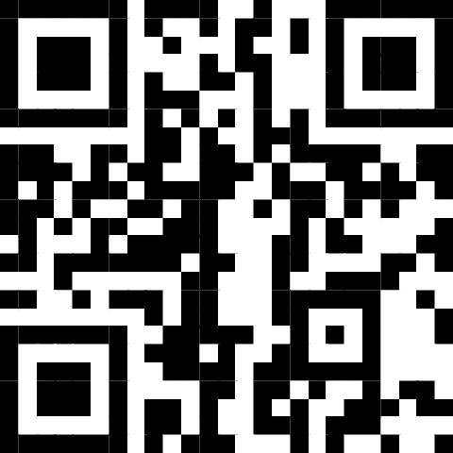
Introduction to Machine Learning
Course Leader: ​
Simon Kirby​
​
Course Helpers: ​
Finley Gibson​
Sam Fletcher​
Coding for Reproducible Research​
Sign in here ​
March 2025
Collaborative doc: https://tinyurl.com/fd3cd22b​

Slide 2
Code of Conduct​
Our ethos is to provide a welcoming and supportive environment for all people, regardless of background or identity. By registering to attend this workshop, participants are agreeing to abide by the Researcher Development Code of Conduct.​
Our goal is to support you to develop your programming skill sets to enable you to do cutting edge research. We want to create a positive and professional learning environment and therefore encourage the following kinds of behaviours:​
Show courtesy and respect towards all who attend a workshop or engage in community events.​
Be respectful of different viewpoints and experiences.​
Gracefully accept constructive criticism.​
Be patient if there are technical glitches. While we know something about how to use computers, we are not immune to internet or hardware issues.​
Respect our policy on not recording workshops to protect the nature of the sessions and ensure we are GDPR compliant.

Slide 3
Programme Funding​
The CfRR training programme is supported by:​
Research Software Analytics Group​
Institute for Data Science and Artificial Intelligence (IDSAI)​
University of Exeter Reproducibility Leadership Team​
EPSRC Research Software Engineering Fellowship​
Community of academics who volunteer their time to support delivery ​
To make the case for continued investment, please help us demonstrate the impact of these sessions by attending all courses you register for and providing feedback at the end of the course.

Slide 4
Intro to Machine Learning
Part 2 - Model selection
and evaluation

Slide 5
Course contents
Session 1
Slides: what is machine learning?
Tutorial: linear regression
Slides: model selection and evaluation
Session 2
Tutorial: model selection and evaluation
Slides: the machine learning pipeline
Tutorial: machine learning pipeline task
Session 3
Continue with machine learning pipeline task
Tutorial: unsupervised learning

Slide 6
How do we get the best possible model performance?
Model training - what is happening?
Model selection - select appropriate model
Model validation - assess generalisability & prevent overfitting
Model evaluation - assess model performance
We are going to discuss these four things.

Slide 7
Training a model
We call this process of learning from data “training”
Launch!
Data
Study the problem
Train ML algorithm
Evaluate
Analyse errors
Diagrams adapted from Hands On Machine Learning with scikit-learn, Keras and Tensorflow by Aurelien Geron

Slide 8
Training a model
Data
Launch!
?
Study the problem
Train ML algorithm
Evaluate
Analyse errors

Slide 9
Training a model
Labels
Our train set
Data
If loss is low enough…
Create model
Make predictions
Calculate loss
Finish training!
Initial model parameters
i.e. maybe a random guess
Repeat this cycle until loss is low enough
Adjust model
If loss is still too high…

Slide 10
Model selection
There are different types of machine learning problem
These will influence what models are appropriate to select
Hence, first stage of machine learning task is to explore your data
The “no free lunch theorem”: Wolpert and Macready
Applied to machine learning: no single best algorithm for predictive modeling problems, i.e. classification and regression.
Means you cannot blindly take a “good” algorithm, and expect it to perform well on a new problem.

Slide 11
Model selection - a warning
Libraries with consistent APIs, such as scikit-learn, make it trivially easy to select different machine learning algorithms, and apply them.
This can be dangerous: it is possible to select a model that is not appropriate for your use case, or that does not make mathematical or physical sense.
Similarly, when tuning parameters, these should also be assessed in a similar way.

Slide 12
Model evaluation
Assess how well the model performs
Metrics such as:
Accuracy (classification)
Precision, recall, f1-score (classification)
MSE/RMSE (regression)
Usually assessed on a test (an unseen) dataset
How do we do this so we are not “marking our own homework?”

Slide 13
Model evaluation - train test split
First thing we should always do is split our data
Train set: the data we use for training our model - commonly 80%
Test set: data we evaluate our model on/assess its performance on - 20%
Should be before you perform serious investigation into the data!
Train data
Test data
Commonly 80% 20%

Slide 14
Train test split: bias
It is really common to hear about problems of bias in ML algorithms.
Bias can creep in at this stage!
Your test set needs to be representative of the training data (and vice versa)
Assessing bias in these splits will also require domain/problem knowledge!
i.e. if your data is sorted by gender, dont take the last 20% as your test set
Because your train set could be mostly the other gender
We can use scikit-learn to do lots of this for us.

Slide 15
Model validation: overfitting vs underfitting
Overfitting: learning the training features.
Symptoms: high accuracy on train set, low accuracy on test set
Underfitting: model has not/cannot learnt the training features
Symptoms: low accuracy on train AND test sets

Slide 16
Model validation: overfitting vs underfitting
This can be visualised with a polynomial with different degrees of freedom
Output variable
Output variable
Output variable
Predictor variable
Predictor variable
Predictor variable
Model is underfitting:
Poor accuracy, but not possible to learn the shape of the data
Model is fitting well:
Good accuracy: general shape learnt well
Model is overfitting:
Perfect accuracy on this data. So what is the problem?

Slide 17
Model validation: overfitting vs underfitting
Lets add a new, unseen point. This could be from the test set.
Output variable
Output variable
Output variable
Predictor variable
Predictor variable
Predictor variable
Model does not predict new point well
Model predicts new point well
Model does not predict new point well

Slide 18
Model validation: bias variance tradeoff
Total error is a function of the bias and the variance
Optimum model complexity
Total error
Variance
Error
Bias squared
Model complexity

Slide 19
Model validation: bias variance tradeoff
Total error is a function of the bias and the variance
Output variable
Output variable
Output variable
Predictor variable
Predictor variable
Predictor variable
Low complexity, high bias, low variance
Optimal complexity, minimises error
Optimal balance of bias and variance
High complexity, low bias, high variance

Slide 20
Model validation: in summary
A model that is generalisable makes accurate predictions on new, unseen data.
Models that do not generalise well have not learned a true relationship between the input features, and the outcomes.
A model that has been overfit is often not generalisable.

Slide 21
Better evaluation: validation holdout
During training, we can split our training set up into a train set and a validation set
Train data
Test data
This is a good way of preventing overfitting.
Introduces a problem: reduces the size of our train set.
Commonly 80% 20%
Train data
Test data
Split validation from train data

Slide 22
Better evaluation: validation holdout
We can do this k times: k-fold cross validation. Allows us to still use this validation data in training.
Train data
Test data
Commonly 80% 20%
We assess the performance on each “fold”, helping to reduce change of overfitting
Test data
k = 1

Slide 23
Better evaluation: validation holdout
We can do this k times: k-fold cross validation. Allows us to still use this validation data in training.
Train data
Test data
Commonly 80% 20%
We assess the performance on each “fold”, helping to reduce change of overfitting
Test data
k = 2

Slide 24
Better evaluation: validation holdout
We can do this k times: k-fold cross validation. Allows us to still use this validation data in training.
Train data
Test data
Commonly 80% 20%
We assess the performance on each “fold”, helping to reduce change of overfitting
Test data
k = 3

Slide 25
Better evaluation: validation holdout
We can do this k times: k-fold cross validation. Allows us to still use this validation data in training.
Train data
Test data
Commonly 80% 20%
We assess the performance on each “fold”, helping to reduce change of overfitting
Test data
k = 4

Slide 26
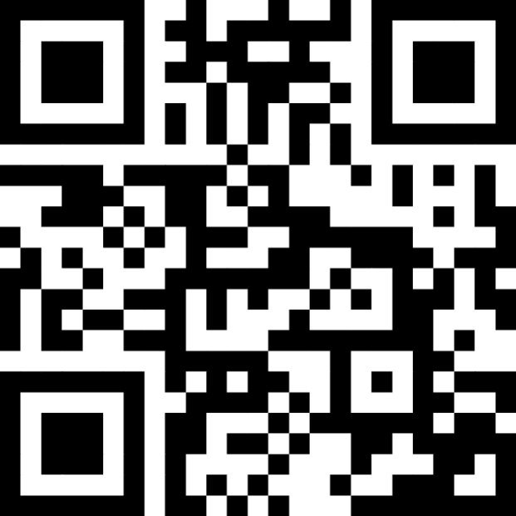
Thank you!
Post-workshop Anonymous Feedback Form 2024-25​
https://tinyurl.com/2d8fys7e​

